Slide 1

Apache Hadoop

Slide 2
Introduction
Hadoop is a collection of open-source software utilities that facilitates using a network of many computers to solve problems involving massive amounts of data and computing.
It provides a software framework for distributed storage and processing of Big Data using the MapReduce Model.

Slide 3
Trivia
The original authors of Hadoop are Doug Cutting and Mike Cafarella.
The name Hadoop comes from a yellow toy elephant that was owned by Doug Cutting’s son.
Apache Hadoop version 1.0 was released on December 15, 2011.
The current stable version is 3.3.2 (as of March 06, 2022).

Slide 4
Implementation
The main implementation language is Java with some native code written in C and command-line utilities written in shell scripts.
Though Java is commonly used for MapReduce jobs, through the use of Hadoop Streaming any programming language can be used to write MapReduce tasks.
Requires JRE 1.6+ to run.

Slide 5
Base Modules
Hadoop Common: Libraries and utilities needed by other modules.
Hadoop Distributed File System (HDFS): A distributed file system which stores data on commodity hardware.

Slide 6
Hadoop YARN (Yet Another Resource Negotiator): A platform responsible for managing computing resources in a cluster and using them to schedule user’s applications. (2012)
Hadoop MapReduce: An implementation of the MapReduce programming model for large scale data processing.
Hadoop Ozone: An object store for Hadoop. (2020)

Slide 7
Architecture
Hadoop runs in a master-slave architecture.
Hadoop consists of the Hadoop Common package which allows file system and OS level abstractions, a MapReduce engine (MapReduce/MR1 or YARN/MR2) and the Hadoop Distributed File System (HDFS).
The Hadoop Common package contains JAR files and scripts required to run Hadoop.

Slide 8
A Hadoop instance is divided into HDFS and MapReduce.
HDFS is used to store the data and MapReduce is used to process the data.

Slide 9
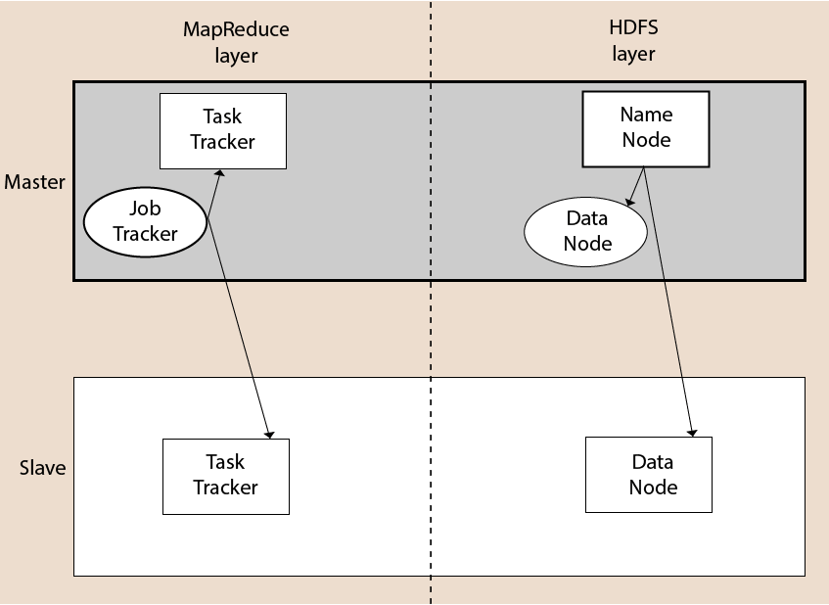

Slide 10
HDFS
The Hadoop Distributed File System (HDFS) is a distributed, scalable and portable file system written in Java for the Hadoop framework.
HDFS works in a master-slave configuration with one master (Name Node) and multiple slaves (Data Nodes).

Slide 11
HDFS has the following services:
  Name Node
  Secondary Name Node
  Job Tracker
  Data Node
  Task Tracker.
Top three services are Master services and the rest are Slave services.

Slide 12
HDFS Services
Name Node:
  Only one present in a cluster.
  Tracks files, manages filesystem and has metadata of all stored data within it.
  Has a direct contact with the client.
Secondary Name Node:
  Also called checkpoint node.
  Takes care of the file system metadata checkpoints found in the Master node.

Slide 13
Job Tracker:
  Receives MapReduce execution requests from the client.
  It then talks to the NameNode for the location of data to be processed upon which the NameNode returns the metadata of the required data.

Slide 14
Data Node:
  Stores data as blocks.
  Actually stores the data into the HDFS.
  Is a slave node to the Name Node.
Task Tracker:
  Slave node to the Job Tracker.
  Takes the job (with the code) from the Job Tracker and applies the code to the data file.

Slide 15
MapReduce Engine
The client submits a MapReduce job to a JobTracker which has a single instance over the entire cluster.
The JobTracker then pushes the job onto an available TaskTracker nodes while making sure that the work is kept as close as possible to the data.

Slide 16
Advantages
Fast
Scalable
Cost Effective
Resilient to failure

Slide 17
Applications
Log or clickstream analytics.
Marketing Analytics.
Machine Learning and Data Mining.
Image Processing.
XML Message Processing.
Web Crawling.
Archival work.

Slide 18
Thanks

